Slide 1
Wallpaper Collection
Filipa Ivanković & Lucijan Pavić

Slide 2
Application Definition Statement
Wallpaper collection is an application for downloading locally stored images and images retrieved from an API. The application displays a collection of wallpapers available for downloading and setting as a wallpaper on your IPhone/IPad.

Slide 3
Features
Downloading wallpapers
Local or from API
Favorite Page
Unfavorite
Delete favorites
Search and filter wallpapers by name or tags
Lottie animations
Retrieving random images from Unsplash API

Slide 4
Third-party frameworks
LottieFiles - animations
SDWebImage - displaying wallpapers retrieved from API
Unsplash API

Slide 5
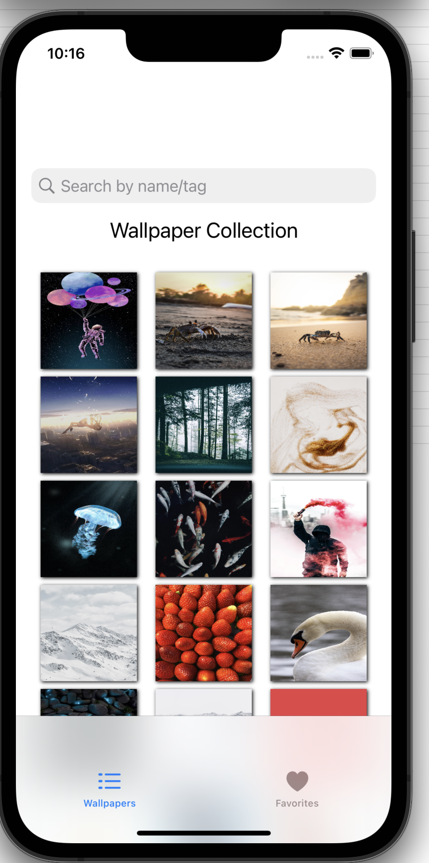
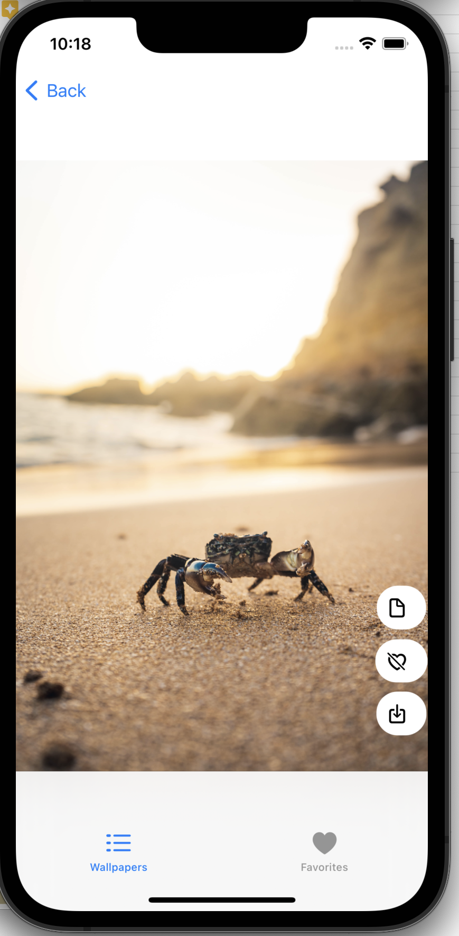
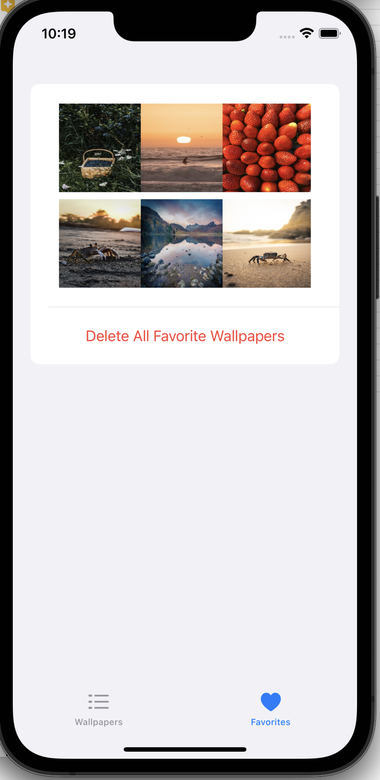

Slide 6
Thank you for your attention!
Questions?

